Slide 1
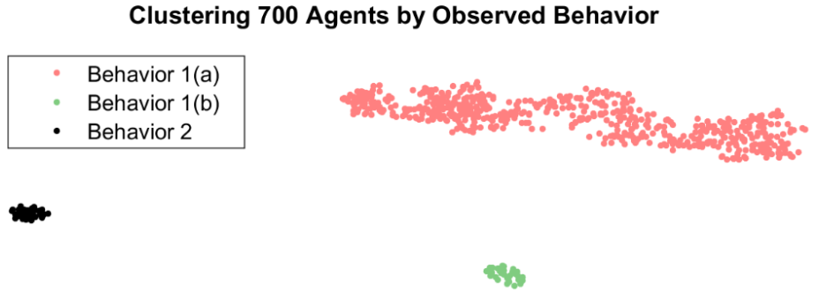
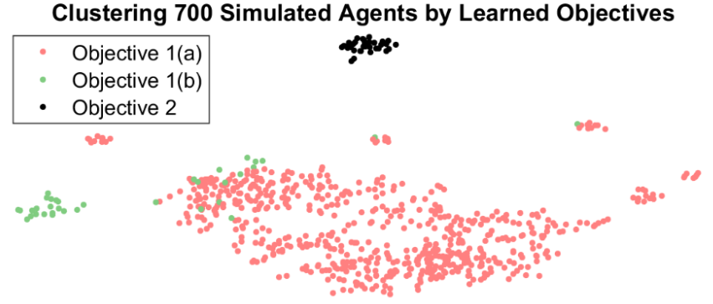
Assistive Agents for Self-Represented Litigants
Novelty of Approach
By seeing human agents as RL’s we can use existing research to explain behavior
Because the RL framework is built for computers software can understand it
Objectives
Show RL application to assistive agents
Discover SRL goals from behavior
Find new paths of research for assistive agents for Self-represent litigants
Deliverables
A framework for estimating SRL goals
An MDP which captures the SRL process
Source code to determine SRL goals
Submission to the 2018 TIG Conference
Benefits to IAB
More positive legal outcomes for SRL’s
More access to legal services for SRL’s
Ability to use MDP’s for human systems
Proof of concept in creating SRL assistant

